Slide 1
KONGSBERG Oil & Gas Technologies AS
How to connect K-Spice to 3rd party OPC applications

Slide 2
Integration of K-Spice to 3rd Party OPC Applications
OpcDaCom (OPC-Client) to an OPC-Server in the 3rd Party Application
Ref. example in slide 4, Matrikon OPC Server to Softing OPC Client

Slide 3
Software Components
Automation of simulation
User interfaces for configuration and operation
Enterprise connectivity and data sharing
SimExplorer
(e.g. Instructor
Interface)
SimExplorer
(e.g. Operator
Interface)
Script (MCL) Interpreter
Web
Service
3rd Party
OPC Server
Starts and manages models and communication drivers
Broker between the models and the user interface
Controls entire simulation system
Simulation
Manager
Communication to control systems, historians or safety systems
Model
Server
Model
Server
External System
Driver
External System
Driver
Model
Server
External System
Driver
External System
Driver
Model
Server
External System
Driver
External System
Driver
Model
Server
External System
Driver
External
Systems
Each model server runs a set of modules that simulate a process or do a calculation
External System
Driver
LedaFlow, other multiphase simulators, anti-surge controllers.
External System
Driver
External System
Driver
External
Models
Control systems, historians or safety systems

Slide 4
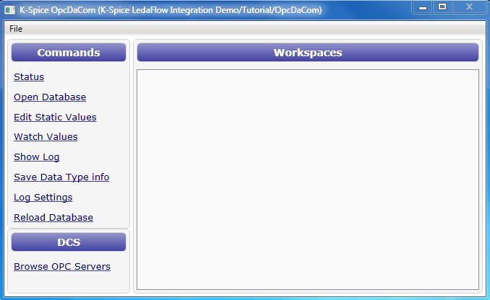
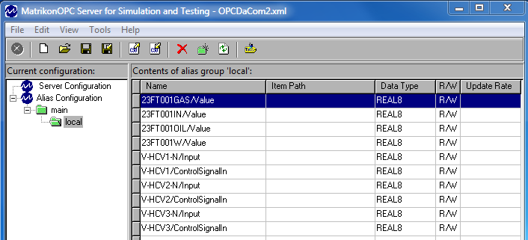
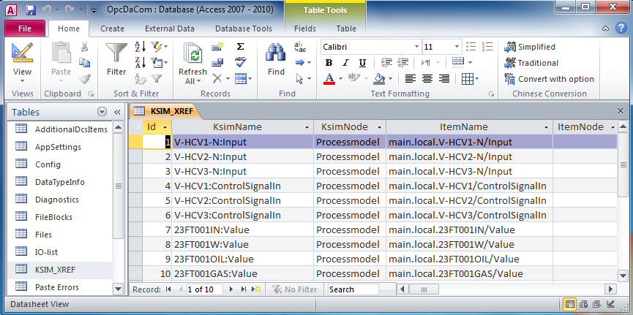
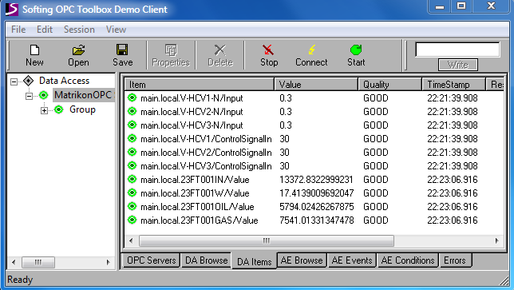
Connect K-Spice to 3rd Party Applications via OPC-DA
K-Spice
Simulation Manager
OpcDaCom
(OPC Client)
Matrikon OPC Server
Softing
OPC Client
I/O database (mdb)
K-Spice
3rd Party OPC Applications

Slide 5
Connect K-Spice “Plant” to K-Spice “Online” via OPC-DA
K-Spice
Simulation Manager
OpcDaCom
(OPC Client)
Matrikon OPC Server
OpcDaCom
(OPC Client)
K-Spice
Simulation Manager
I/O database (mdb)
I/O database (mdb)
K-Spice “Plant”
K-Spice “Online”

Slide 6
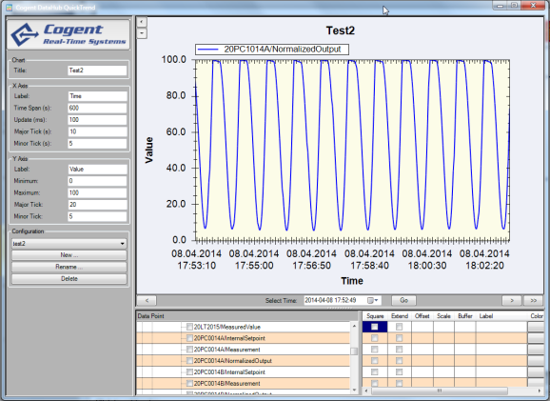
Connect K-Spice to 3rd Party Applications via OPC-DA
K-Spice
Simulation Manager
DeltaV-Com
(OPC Client)
Delta V
OPC Tunneler
Delta V
OPC Tunneler
Delta V
OPC Server
I/O database (mdb)
Cogent
Datahub
K-Spice PC
DeltaV-PC

Slide 7
K-Spice OpcDaCom Setup

